Slide 1
Great adventures with a clear conscience
Sustainability Report 2023: Results and future ambitions
February 2024

Slide 2
Contents
INTRODUCTION 3 OUR SUSTAINABILITY STRATEGY 4
CLIMATE & ENVIRONMENT 6
ANIMAL WELFARE 10
- HIGHLIGHT: KAPAMA PRIVATE GAME RESERVE, SOUTH AFRICA 11
SOCIAL RESPONSIBILITY 12
- HIGHLIGHT: RAINFOREST ECO LODGE, SRI LANKA 13
- HIGHLIGHT: LOST CITY TREK, COLOMBIA 14
- HIGHLIGHT: MOSHI KIDS CENTRE, TANZANIA 15
CARE FOR PEOPLE 16
- WORKING CONDITIONS FOR GUIDES AND PORTERS, KILIMANJARO 17
PEOPLE & CULTURE 18
GOALS FOR 2024 19

Slide 3
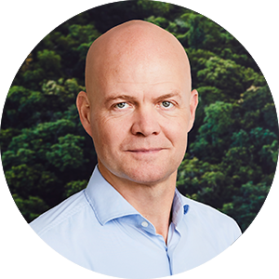
Introduction
CLAUS PALMGREN JESSEN, CEO OF TOURCOMPASS
At TourCompass, we believe that travel brings people together and builds an understanding of other cultures and customs around the world.
In troubled times, it’s perhaps more important than ever that we all expand our horizons and learn – and embrace – something new.
And that’s very much what we do, here in our own little world.
Our work with sustainability over the past year has shown us that it is every bit as exciting, important and not least as challenging as we had expected. Sustainability is a concept in constant motion, and every day we learn something new.
During the past year, we have introduced a number of new initiatives to several of our tours. These initiatives support local communities, fight social inequality and take care of nature and wildlife. Our mission states that our tours must help create a better world – both for our guests and for those we visit around the world.
You can read more about some of these initiatives on the following pages.
Our work to have a positive impact on the world – and hopefully on our guests as well – will continue in the coming years, and it is our goal to add at least 10 new initiatives in 2024.
Looking ahead to 2024, one of our major goals is to increase our focus on protecting and promoting biodiversity. This involves support for initiatives and conservation efforts that make a positive contribution to the natural areas that our guests visit almost daily.
We are also in the process of developing a policy for booking flights. It is our goal that as many tours as possible are booked through airlines that share our ambition to reduce our carbon emissions and promote more sustainable transport options.
We will also continue to expand our work to combat social inequality by integrating further initiatives into our tours that both benefit local communities and provide our guests with deeper and more meaningful experiences.
Finally, we will be maintaining our ongoing efforts to ensure a high level of employee satisfaction in our team, for the benefit of our employees, customers, business partners and TourCompass.
Claus Palmgren Jessen CEO, TourCompass

Slide 4
Our Sustainability Strategy
Climate change is one of the biggest challenges the planet is facing. We’re already seeing the consequences around the world, with extreme weather becoming more frequent, and changing rainfall patterns are making living conditions difficult. Several of the planet’s limits have already been exceeded, and the world we live in – and off – is changing.
As a tour operator, we share the responsibility for trying to reduce carbon emissions. According to figures from World Economic Forum and WTTC (the World Tourism and Travel Council), among others, up to 10% of the world’s total carbon emissions come, in one way or another, from the tourism industry. There is still a big question mark over these figures, as many factors are difficult to measure – and in many places there are no real standards for how to measure at all. However, this does not change the fact that, as tour operators, we have a responsibility.
However, the large footprint left by tourism should also be seen in a different light, i.e. that tourism accounts for a large part of the world’s total gross domestic product. It is estimated that up to 10% of the world’s total gross domestic product comes from tourism – though naturally with major regional differences².
So, we have a huge responsibility. But we also have a huge opportunity. We can actually make a difference if we work purposefully and strategically with sustainability.
In public debate, sustainability is often equated with climate change. Our climate goals are in line with the Paris Agreement³, but we believe that sustainability as a concept extends way beyond climate and the environment. We have a unique opportunity to make a positive impact on the world we live in – both socially and environmentally.
We’ve made some choices. It hasn’t been easy – but we believe they are necessary.

Slide 5
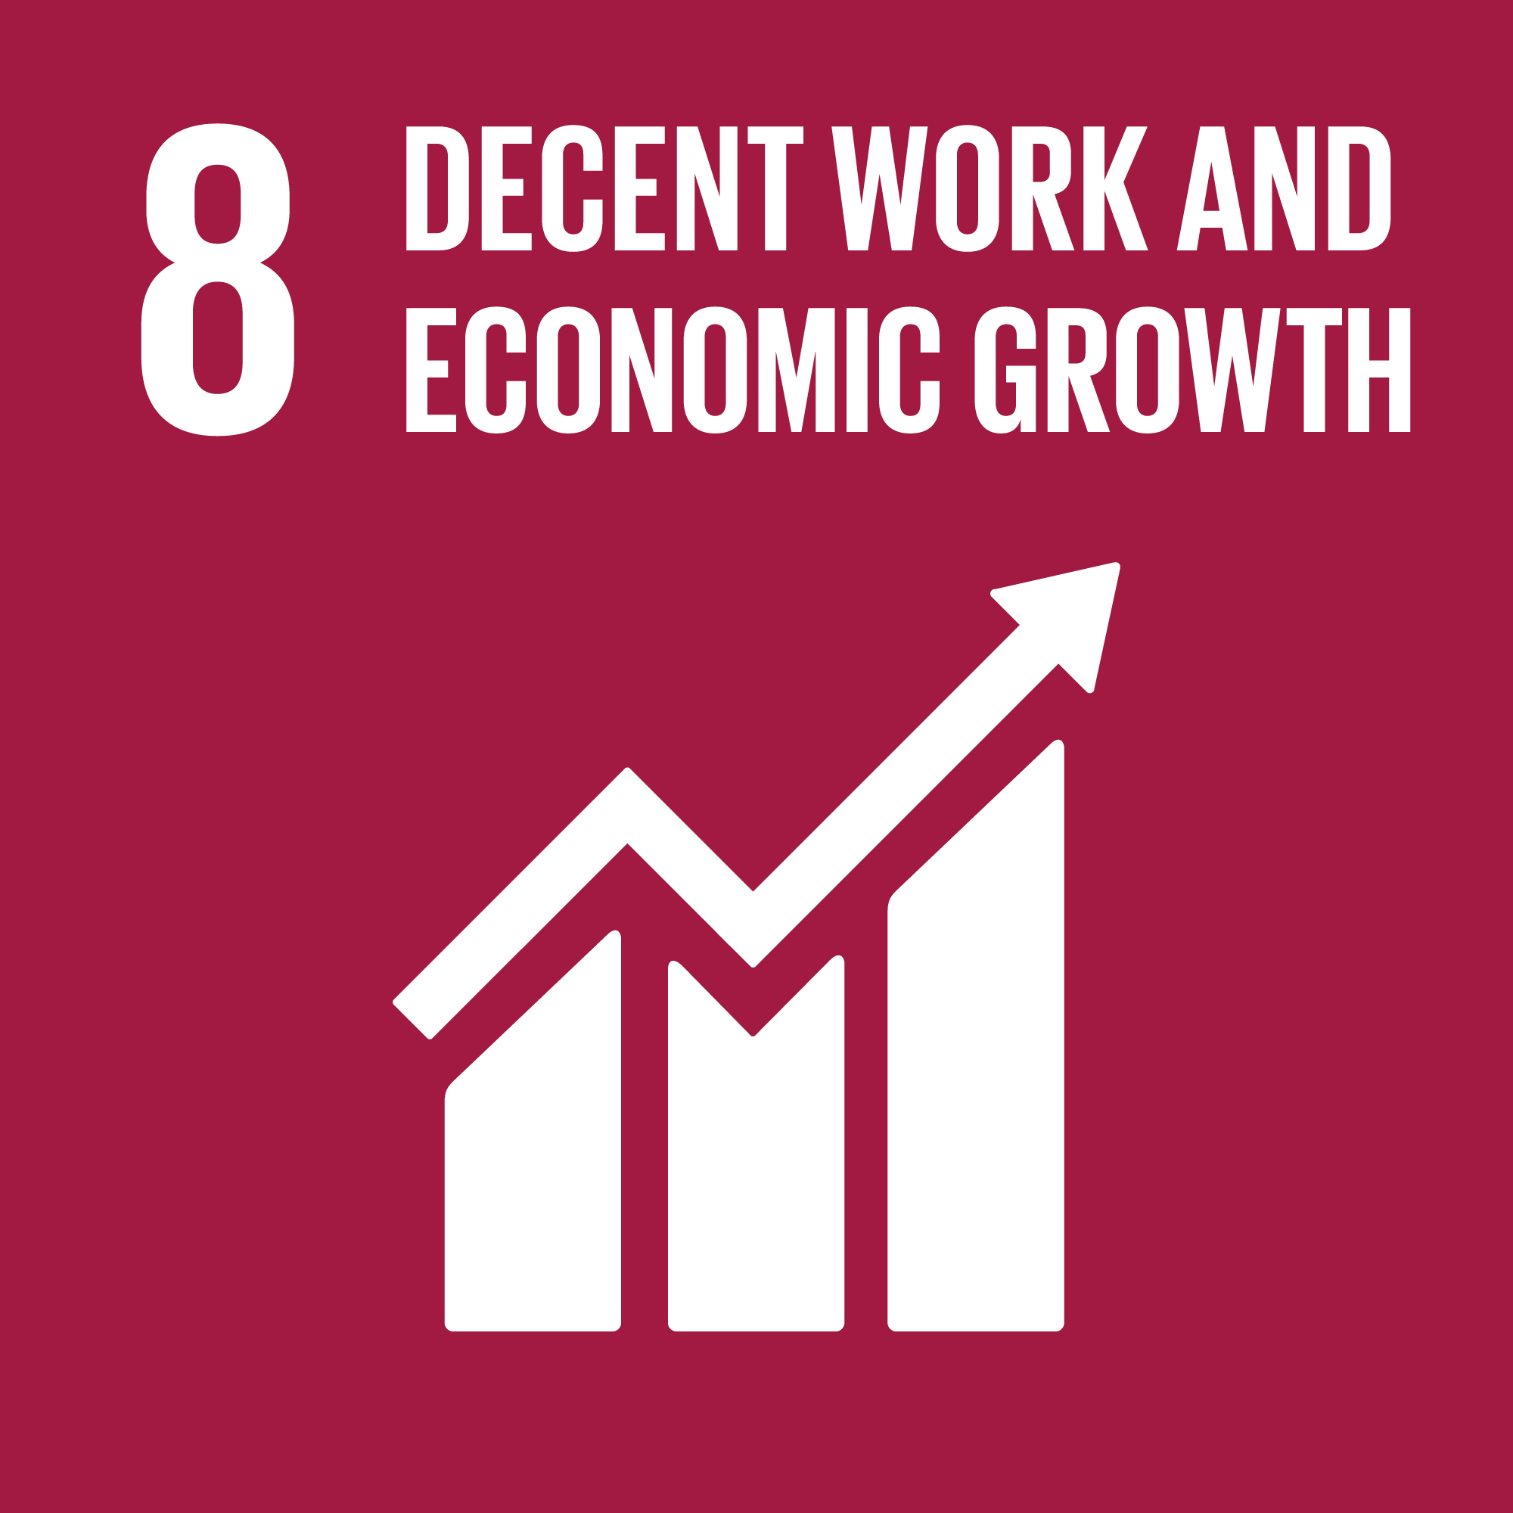
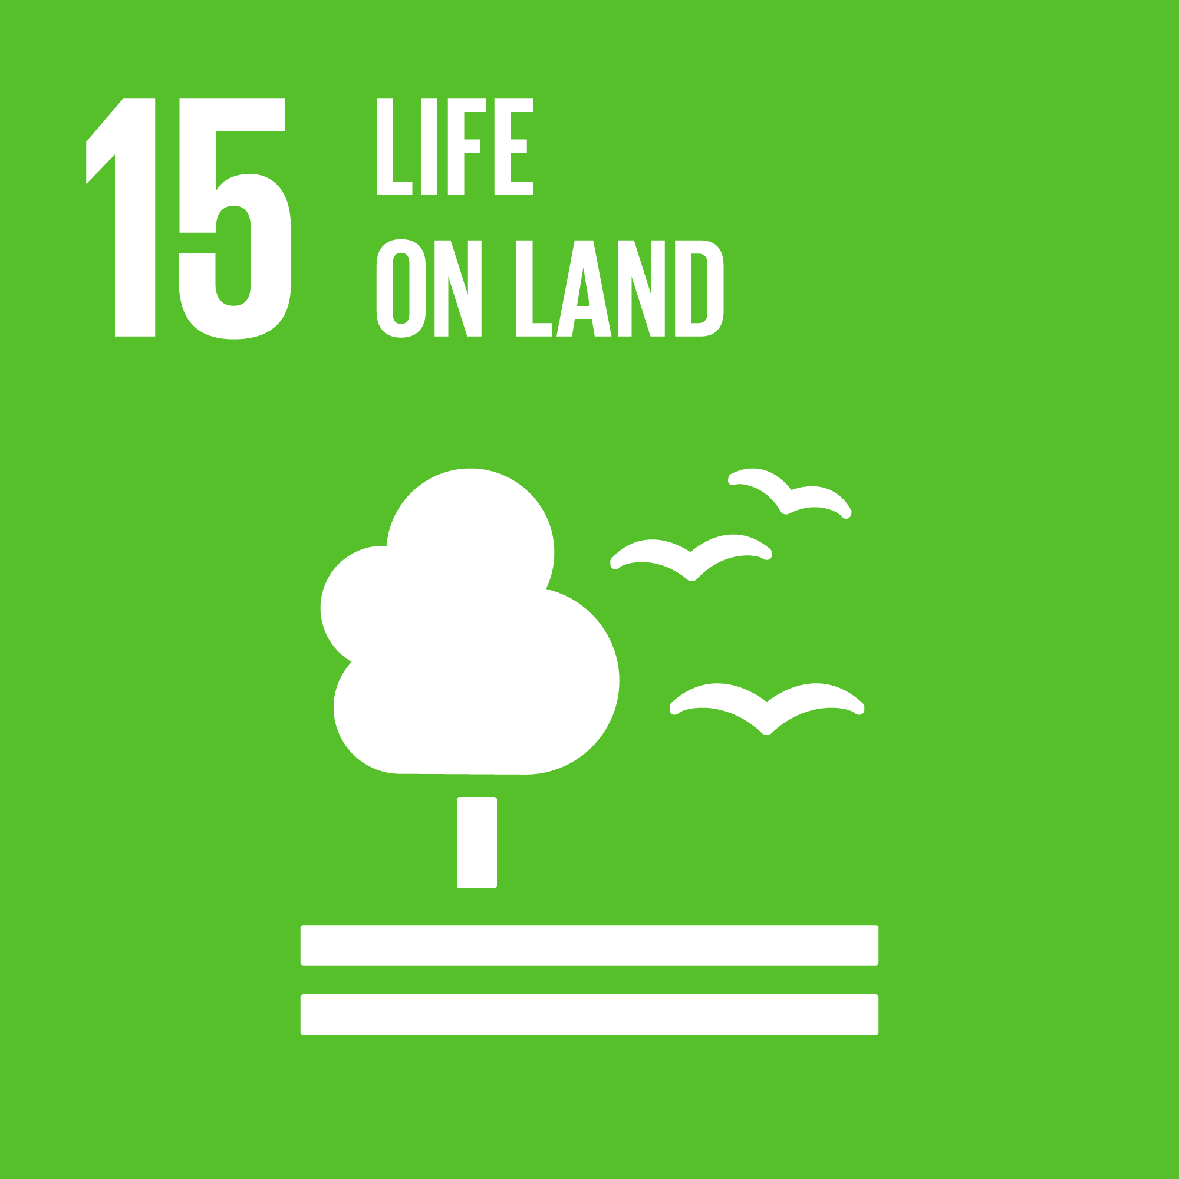
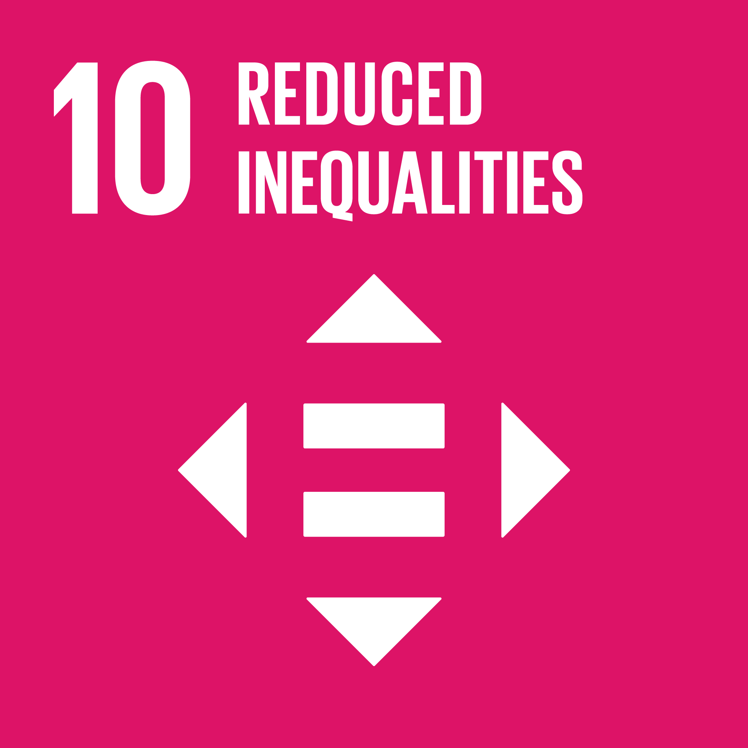
OUR SUSTAINABILITY STRATEGY
Focus areas
Our focus areas are all in line with the UN Sustainable Development Goals and will, among other things, help to:
When we prepared our first Sustainability Report in 2022, we identified 4 focus areas that we believe are absolutely central to running a sustainable business:
Climate & environment: Reduction of carbon emissions in connection with our tours.
Social responsibility: Support of disadvantaged local communities.
Responsibility for nature: Focus on animal welfare.
Governance: Decent, lawful behaviour, conforming to conventionally accepted standards of propriety and morals
In 2024, we will be adding biodiversity as a further focus area.
Support the opportunity of children and young people to attend school and obtain an education through projects and partners.
Reduce our total
carbon emissions.
Generate economic growth in disadvantaged areas by using local business partners.
Ensure that we look after nature and wildlife through our Animal Welfare Policy.
Reduce inequality by focusing on particularly disadvantaged local communities.
Ensure that changes take place in collaboration with local partners and are anchored locally.

Slide 6
Climate & environment
Our climate goals are in line with the Paris Agreement, which is the global goal of keeping temperature increases below 1.5 degrees Celsius.
These goals are:
To ensure that our own locations have zero emissions of greenhouse gases by 2030.
To reduce the total emission of greenhouse gases before 2030, and to achieve zero emissions by 2050 in connection with our tours.
To help and guide us in this process, we have set specific subsidiary goals, which are our benchmarks for achieving our overall 2030 reduction target. We will adapt both our subsidiary goals and our efforts as we become wiser.
Our subsidiary goals include:
We have converted all our electricity purchases to green energy at all our locations where this has been possible. Our work to reduce energy consumption will also continue after 2025.
Means of transport at the destinations running on sustainable energy have increased by 50%, and the total number of km driven (as of 2019) has been reduced by 20%.
At least 50% of our tours must be with airlines that have an emissions and/or reduction strategy that meets the goals of the Paris Agreement.
We only select hotels and accommodation that have either already attained the goal of zero carbon emissions or have a realistic and concrete plan to achieve this within the next five years.
2025
2026
Our climate goals are ambitious, and so it makes us very proud that they were validated according to Science Based Targets Initiative⁴ in 2023.
2030

Slide 7
CLIMATE AND ENVIRONMENT
Measurement of goals and subsidiary goals
In order for us to be able to keep stock of our goals and subsidiary goals, we prepare an annual climate report in which we measure our total emission of greenhouse gases.
We measure according to the Greenhouse Gas (GHG) protocol⁵, which is the leading international standard for how to measure the company’s emissions of greenhouse gases. By following an international standard, we can ensure that our measures are comparable.
In the GHG protocol, greenhouse gas emissions are divided into three so-called “scopes”.
Scope 1 covers emissions from a company’s own premises, machinery and vehicles (e.g. through the burning of petrol, diesel or natural gas).
Scope 2 covers emissions associated with the production of the energy that a company buys (such as electricity and district heating).
Scope 3 covers all other indirect emissions that occur in the company’s value chain (including upstream procurement and downstream waste management)
5. https://ghgprotocol.org/

Slide 8
CLIMATE AND ENVIRONMENT
The first CO2e reductions in the years leading up to 2030 will be achieved through increased energy efficiency in our own offices.
At the same time, we are starting to influence the reduction of emissions in connection with our tours. We have a particular focus on three areas:
International flights We might not be able to control the reduction of carbon emissions from international flights directly, but we can create an overview of the airlines’ emissions and what they are doing to reduce them. Our first step is therefore to collect this information. Based on this, we will formulate a policy for selecting airlines that either emit the least or have a clear plan to reduce their carbon emissions. Our goal is to have a clear and defined flight policy in place by mid-2024.
Hotels at the destinations Several of our hotels are already engaged in sustainability work, and it is TourCompass' goal to accelerate this process. The first step is to gain a clear picture of how far each hotel has come on its sustainability journey, as well as what plans they have to reduce their carbon emissions in the future. Armed with this knowledge, we can favour cooperation with the hotels that are furthest ahead with their climate efforts, and we can support the others in their efforts to run their business in the most climate-friendly way. In 2024, we have set out to map and assess the CO2 emissions from our ten most popular hotels.
Transport at the destinations We start by mapping and planning how we can reduce the number and length of the journeys we make. We will then draw up a strategy for how and at what pace we can transition to non-fossil fuel vehicles. By 2024, we aim to replace car travel with train travel on at least one of our ten most popular tours, and to implement electric car transport at at least one of our destinations.
Key figures
The table below shows key figures for TourCompass in 2019, 2022 and 2023. The years 2020 and 2021 have been omitted from the report, as the figures are not accurate due to the Covid-19 pandemic.
The absolute emissions in Scopes 1 and 2 as well as the absolute emissions in Scopes 1, 2 and 3 are shown here, together with relative key figures which reflect the number of customers we had in 2019, 2022 and 2023.
From 2019 to 2023, we see a 27% decrease in absolute emissions for Scopes 1 and 2, while emissions per customer within these scopes have increased by 9%. This decrease is mainly due to the conversion to green power in our offices.
At the same time, the absolute emission in Scopes 1, 2 and 3 has decreased by 23% between 2019 and 2023, while the emission in Scopes 1, 2 and 3 per customer has increased by 13%. The latter increase can partly be explained by the introduction of Australia as a new destination.

Slide 9
CLIMATE AND ENVIRONMENT
Paperless vouchers in Peru, Ecuador & Colombia
In a number of countries in Latin America, together with our partner, we have abolished the traditional paper vouchers.
Instead, upon their arrival in these countries, our guests simply receive a QR code that they have to scan, which gives them access to all their local vouchers, their itinerary and information about the countries.
Green electricity
On 1 December 2023, we rescheduled all our power purchases at our Danish office. This means that 100% of our electricity now comes from renewable energy sources. Our total carbon emissions from power consumption will therefore be up to 90% lower in 2024 than in our baseline year, 2019.

Slide 10
Animal welfare
In 2023, we have continued our fruitful cooperation with World Animal Protection regarding animal welfare.
So, when you travel with TourCompass, you cannot:
Swim with dolphins in captivity
Ride elephants
Pat lions and cheetahs
Take selfies with tigers
Watch monkey or bear shows
In line with our animal welfare policy, in 2023 we removed several day excursions that we did not believe met these guidelines; diving with sharks in South Africa and the possibility of dolphin watching at Lovina in Bali.
Instead, we support responsible, well-run, animal-friendly reserves and rescue and rehabilitation centres recognised, where possible, by World Animal Protection. These help support the phasing out of wild animals in captivity, and their aim is to reintroduce the animals into their natural habitat if possible
When you travel with TourCompass, you are thus contributing to increased focus on and demand for more animal-friendly tourism that both protects the animals and supports the work at the reserves and rescue and rehabilitation centres.
One of our goals for 2024 is to increase our focus on biodiversity and the conservation of threatened ecosystems.

Slide 11
ANIMAL WELFARE
HIGHLIGHT
Kapama Private Game Reserve, South Africa
In 1986, the South African farmer Johann Roode purchased a piece of land in Limpopo province close to Kruger National Park, where he wanted to raise cattle. But things didn’t quite go to plan. Disease and (especially) predators made a big dent in his cattle population, and it didn’t take long for him to realise that the area was not suitable for cattle farming. The predators, on the other hand, thrived in the area, and instead of a cattle farm, he decided to use the land to create a private game reserve.
The story could end here, but it doesn’t.
Roode kept buying up land, and the game reserve grew and grew. In the same year (1993) that Nelson Mandela and F.W. de Klerk won the Nobel Peace Prize, Kapama Private Game Reserve was founded.
Sustainability is in many ways at the core of Kapama’s history, and since Roode bought his piece of land, the projects have only grown – both in number and footprint.
It was soon realised that if nature and wildlife were to be preserved, the local population had to be involved. Kapama has therefore initiated for a large number of projects which strengthen the local community economically. This ensures education and creates jobs, and in doing so contributes to future generations learning about the environment, nature conservation, biodiversity, etc.
The lodge has installed a gigantic photovoltaic system, and works actively with waste sorting, waste water recycling, and mainly buys food from local farmers, thus avoiding long transportation, and supporting the local community. At Kapama, they think about their footprint – and about YOUR footprint, too, when you visit the lodge.
As a guest, you have the opportunity to visit one of the schools that Kapama supports, and it’s possible to support the projects – just ask at the lodge!

Slide 12
Social responsibility
As a travel agency, we make choices every day when we put together our travel itineraries.
Through our presence at our various destinations, we can help make a difference. We actively choose which hotels we use, the business partners we have and which excursions we offer our guests.
It is our ambition to work purposefully to select products through which we can actively make a positive impact on the individual destinations.
We work continuously to screen our products and to clarify the requirements we have for our many partners.
We also have an ambition to increase our direct support in some of the particularly vulnerable areas that we and our guests visit. We work purposefully on a daily basis to identify and develop projects where we can help make a difference.
To let people know what we actually do, in 2023 we introduced a new sustainability page on our websites, where we present our projects:
tourcompass.dk/baeredygtighed.htm

Slide 13
SOCIAL RESPONSIBILITY
HIGHLIGHT
The Rainforest Eco Lodge, Sri Lanka
Situated in the heart of a Sri Lankan tea plantation is the Rainforest Eco Lodge.
The lodge is the result of a collaboration between the Sri Lankan government and USAID with a view to strengthening tourism in Sri Lanka.
The Rainforest Eco Lodge is the only LEED platinum-certified accommodation in Sri Lanka, the 4th in Asia and the 5th in the world. The lodge has thus been built according to special sustainable guidelines that have ensured that its construction has not destroyed or disturbed the rainforest habitat and the local community, which consists of 30 families who all work in the tea plantation.
Before the construction of The Rainforest Eco Lodge, the families lived in extremely poor conditions. The hotel management decided that, for the lodge to be a success, it was necessary to improve the living conditions of the local people and give them access to better and more opportunities. The decision was therefore made to build them a new village near the old one, with improved housing with sanitary facilities, electricity and access to clean drinking water, which is financed by The Rainforest Eco Lodge. A new school was also built for the village’s children, where the teachers are paid by The Rainforest Eco Lodge. Every Monday, the pupils are given a free lunch, and every Wednesday, the children are taught English by the hotel management.
The Rainforest Eco Lodge’s ambition is for the “community outreach” programme to develop over time and expand to include even more focus areas to improve the living conditions of the local community.
Green energy and eco-friendly solutions are a major focus for The Rainforest Eco Lodge, which helps to reduce the environmental footprint through cleaning waste water and reducing carbon emissions with the help of solar panels.

Slide 14
SOCIAL RESPONSIBILITY
HIGHLIGHT
Lost City Trek, Colombia
Hidden away in Colombia is one of the most exciting pre-Columbian ruins in Latin America, the impressive complex Ciudad Perdida, perhaps better known as the Lost City.
The Lost City was built by the Tayrona people in around 800 AD, and it is thought to have been abandoned at around the same time that the Spanish colonists arrived in Colombia. For many hundreds of years, the city remained forgotten and hidden by the jungle, until it was rediscovered in 1972 by a group of treasure hunters. Treasures from the lost city turned up in markets around the country, and archaeologists from the Colombian Institute of Anthropology set out to discover where the treasures might have come from – and found the Lost City. Since then, Ciudad Perdida/Lost City has consulted with the Archaeological Institute to ensure the restoration and preservation of the site.
The area was for a number of years affected by the fighting between the Colombian army and right-wing paramilitary groups but has been a safe place to travel to since 2005, and the tourists have returned.
Since 2009, the NGO Global Heritage Fund has worked closely with the Colombian government and the local communities around the Lost City to preserve the area and ensure, among other things, that income from tourism goes back to the local community. They advise and educate local tribal people on the best way to preserve the area for posterity. This means that you cannot visit the Lost City today without a guide. All guides belong to one of the local tribes, and the places where you spend the night on the trek are owned and run by the various tribes in the area.
The income from your visit thus goes back to the local community, providing benefits in the form of jobs, schools, health care, etc.

Slide 15
SOCIAL RESPONSIBILITY
HIGHLIGHT
Moshi Kids Centre, Tanzania
Measured by income per capita, Tanzania is one of the poorest countries in the world.
At the Moshi Kids Centre in Moshi, the NGO Zara Charity works purposefully to give children from underprivileged families a somewhat better start to their school life. Zara Charity identifies families with no experience of going to school, or who cannot afford to send their children to school, and offers the children the chance to attend a pre-school for free, where they are given a meal, clothes and the opportunity to learn how to go to school.
On a day-to-day basis, the aim of the pre-school is to give the children a chance. They are given food and clothes – and the opportunity to be prepared for a different life. The longer-term goal of the pre-school is to set up sponsorships so that the children can go to a REAL school and get an education.
At TourCompass, we support the school with a set monthly amount, so just by buying your tour from us means support for the pre-school.
If you stay at Springlands Hotel in Moshi, for example in connection with your Kilimanjaro trek, you can visit the pre-school, which is a stone’s throw from the hotel. You’re welcome to bring clothes and toys that you can donate to the children, or you can be driven to the market and buy food to donate.

Slide 16
Care for people
It hardly needs saying, but we have to behave decently – both in relation to our own business, and towards our own employees and the many people we work with around the world.
We sell dreams. Dreams that can only be fulfilled through contact between people. First between us and our customers, then between us and our business partners – and finally between our customers and our business partner.
We take that very seriously. There’s a reason why we always think of our business partners as just that – partners.
We’re in this together.
We follow a “code of conduct”, which has also been signed by all our partners. It is in accordance with the principles of UN Global Compact, which ensures protection within the areas of human rights, labour rights, the environment and anti-corruption.

Slide 17
CARE FOR PEOPLE
HIGHLIGHT
Working conditions for guides and porters on Kilimanjaro
Our competent guides and porters are instrumental in you safely reaching the top of Africa’s highest mountain. So, it is important to us that they work under good conditions.
There are a number of different organisations that help to ensure that the porters enjoy decent working conditions. The individual tour operators choose which organisation they work with. Some of the largest organisations are the Tanzania Porters Organization, the Kilimanjaro Porter Assistance Project and the Mount Kilimanjaro Porter Society.
Our partner in Tanzania is a member of KIATO – Kilimanjaro Association of Tour Operators and Mount Kilimanjaro Porters Society (MKPS), one of the largest and oldest porter organisations in Tanzania. This means that all the porters we use on Kilimanjaro are members of MKPS.
MKPS was started on the initiative of the porters themselves, and the independent organisation works for better conditions for guides and porters on Kilimanjaro.
Through Tanzanian legislation, porters on Kilimanjaro are assured a minimum wage, and MKPS membership ensures that the individual porters receive more than the minimum wage. Through MKPS, all porters also receive three meals daily, proper clothing for the mountain (jackets, boots, gloves, etc.), tents, sleeping bags, mattress, etc. In addition, rules have been put in place as to how much each porter may actually carry, and all porters have health insurance. They are also given a course in first aid, English courses and guidance on setting up a bank account, etc. The porters at MKPS, in turn, undertake to help pick up rubbish on the route to the top of Kilimanjaro twice a year.
MKPS is 100% Tanzanian.

Slide 18
People & Culture
At TourCompass, we take pride in looking after our strong corporate culture and at the same time having a high level of employee satisfaction.
So, in 2023, we launched a number of initiatives aimed at ensuring a high level of employee satisfaction and ensuring that we maintain our strong culture.
These initiatives include:
Appointment of a People & Culture Manager
Quarterly employee satisfaction survey giving employees the opportunity to score the company and management on a number of parameters anonymously.
Holding of the People and Culture forum 4 times a year, where management meets to evaluate the latest employee satisfaction survey and initiate new initiatives to further strengthen employee engagement.
We are proud that, seen over the whole year, our satisfaction surveys showed an overall score of 4.3 out of a possible 5 – and, among other things, 92% of our employees answered that they see themselves still being part of TourCompass in 2 years’ time as well.

Slide 19
Goals for 2024
In 2024, we will of course continue to focus on our 4 core areas:
Climate & environment: Reduction of carbon emissions in connection with our tours
Social responsibility: Support of disadvantaged local communities
Responsibility for nature: Focus on animal welfare
Governance: Decent, lawful behaviour, conforming to conventionally accepted standards of propriety and morals
We aim to add one item to the list here: biodiversity. We believe that this is an area that is clearly lacking in our current sustainability work.
One of our most important goals for 2024 is to expand the number of projects we support around the world. We believe we have a unique opportunity to contribute to positive development in many of the countries we travel to – both socially and environmentally.
We believe that travel helps create positive footprints – both for those who experience and for those who create experiences. It is our aim to continually increase the number of projects we support – especially those that have a significant footprint in the local communities.
We are also working purposefully to formulate a flight policy. We work with many airlines, and there is a lot of work involved in mapping out the strategies of them all.
It is also our goal for 2024 to map the emissions of our 10 best-selling hotels, to replace driving by car with trains on at least one of our top-10 best-selling tours, and to introduce transportation by electric vehicles at at least one destination.
We look forward to it!

Slide 20
Goals for 2024

